Slide 1

Applied Data Science- Capstone Project- Battle of Neighbourhoods
By Shweta ijardar

Slide 2
Introduction
As part of Applied Data Science Capstone Project- Battle of Neighbourhoods project, e. g. the analysis and useful preparation of data on venues in city environments; I chose Pune City to find best suitable venues
Highlights of Pune City:
Ranked as "the most liveable city in India" several times
Second largest city in the Indian State of Maharashtra
Known as cultural capital of Maharashtra
Pune boasts several historical monuments and museums and hence attracts lots of tourists
Because of the best education system in Pune, it is also known as Oxford of the east and have students across the world here
Lovely city of 331.3 km² area with many venues with variety of foods
The aim of project is to provide information to visitor about places with best restaurants with help of rating, price per person criteria which would surely help visitors in a city make better informed decisions about the places they should visit
Target audience is tourist as well as students basically the once who are visiting Pune city.
Any company or Entrepreneurs interested in investing in the business of food can use this information like maps, plots from project to choose best place according to rating and price to create a website or a mobile application, which is updated on a regular basis, to allow individuals to the city or even expand same functionality to other places

Slide 3
Data collection
We will fetch data using the two different APIs:
Foursquare API (https://api.foursquare.com/v2/venues/)- We will fetch below type of venue data within 4 km starting from centre of Pune City in each direction.
Name: The name of the venue
Category: The category type as defined by the API
Latitude: The latitude value of the venue
Longitude: The longitude value of the venue
Zomato API(https://developers.zomato.com/api ) - provides information about various venues:
Name: The name of the venue
Address: The complete address of the venue
Rating: The ratings as provided by many users
Price range: The price range the venue belongs to as defined by Zomato
Price for two: The average cost for two people dining at the place. I later convert the same to average price per person by dividing by 2
Latitude: The latitude value of the venue
Longitude: The longitude value of the venue

Slide 4
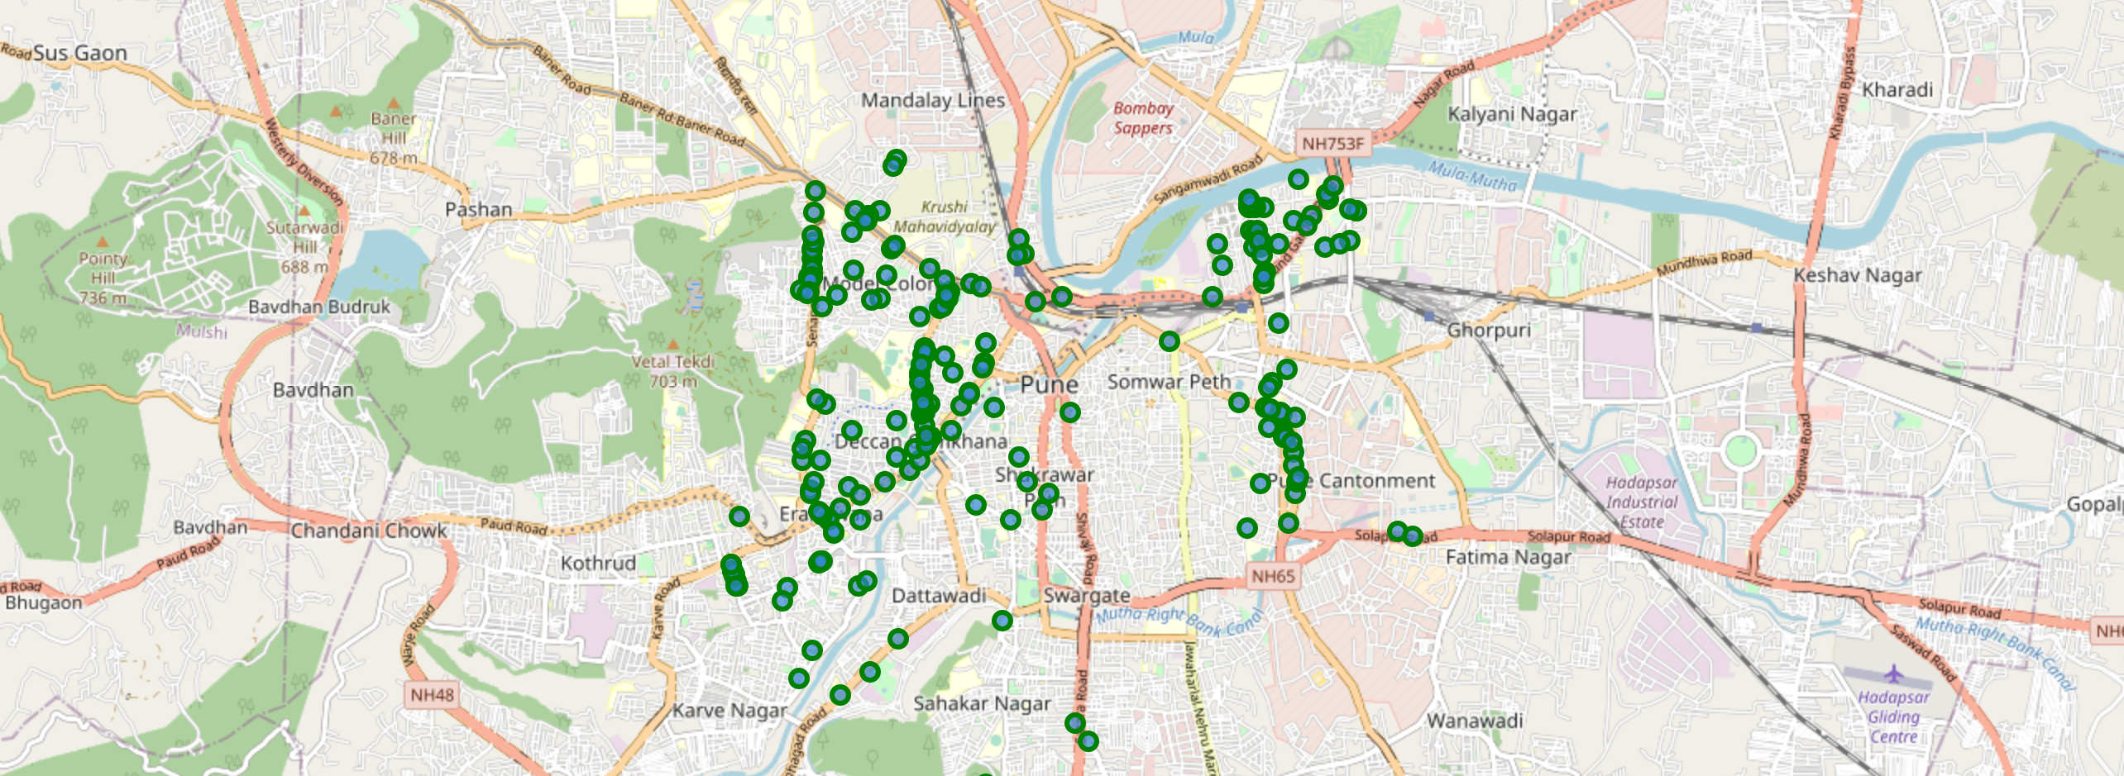
Folium map from foursquare API data

Slide 5
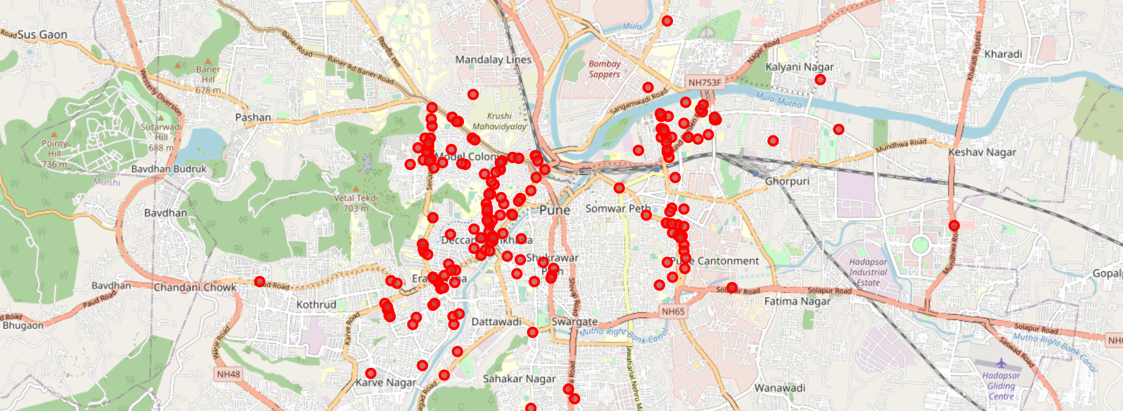
Folium map from ZOMato API data

Slide 6
Data cleaning
After combining the two datasets, I had to check that the latitude and longitude values of each corresponding venue match.
After analysis, I decided to drop all corresponding venues from the two datasets that had their latitude and longitude values different by less than 0.0004 from one another. This removed many outliers from the two datasets.
Once this was done, I observed that there were still some venues which were not correctly aligned.
There are some venues that have specific restaurants/cafes inside them as provided by Zomato API (Restaurant in shopping Mall).
Two locations are so close by that they have practically same latitude and longitude values.
Some venues have been replaced with new venues
Hence data cleaning is needed
We retrieved venues within 4km from center of Pune in each direction which generated total venues as 212 and after careful inspection and removal of data total number of final venues is 109 rows and 8 columns.

Slide 7
Methodology
Identify the top category types of venues using dataset (including rating, average costs, etc...)
This would enable any visitor to identify the venues they want to visit based on their interest.
Explore the areas that are high rated and those that are low rated while also plotting the map of high- and low-priced venues.
The venues will be plot using proper color coding such that a simple glance at the map would reveal the location of the venues as well as give information about them.
Cluster the venues and see if we can draw meaningful information out of what kind of venues exist in Pune

Slide 8
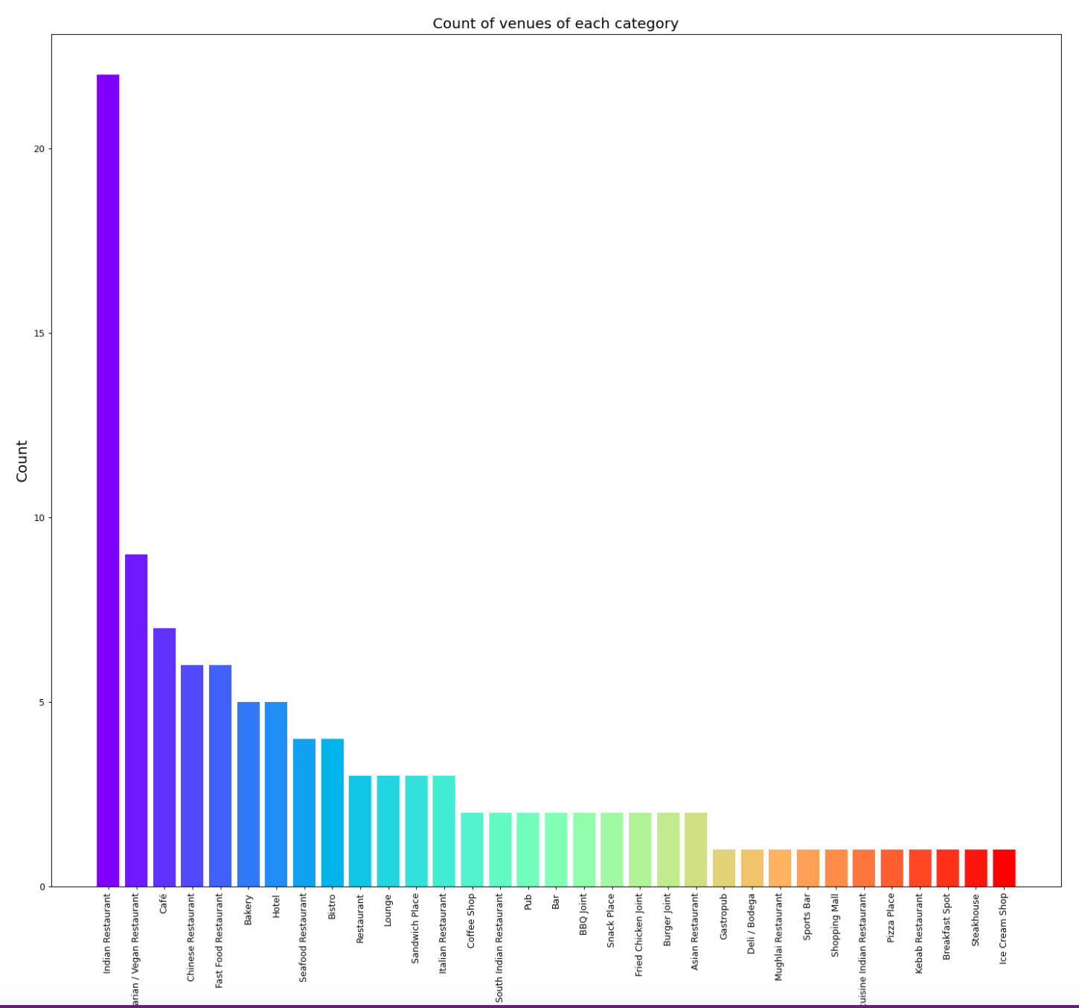
Data analysis: count of venue vs category count

Slide 9
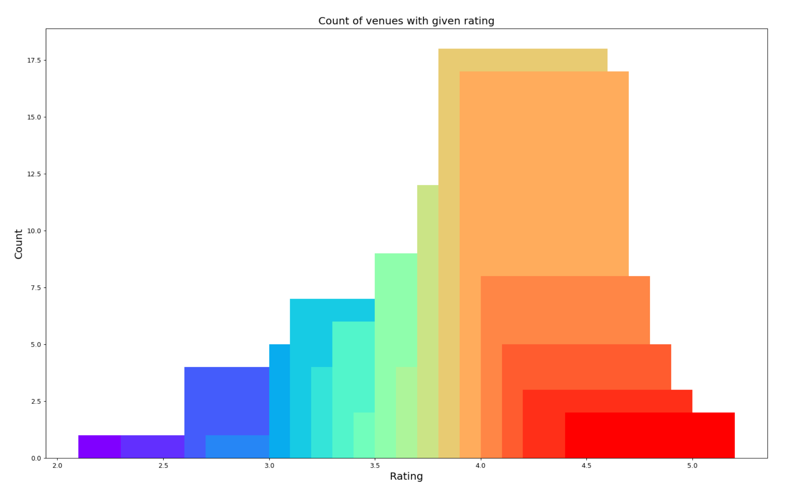
Data analysis: count of venues with given rating

Slide 10
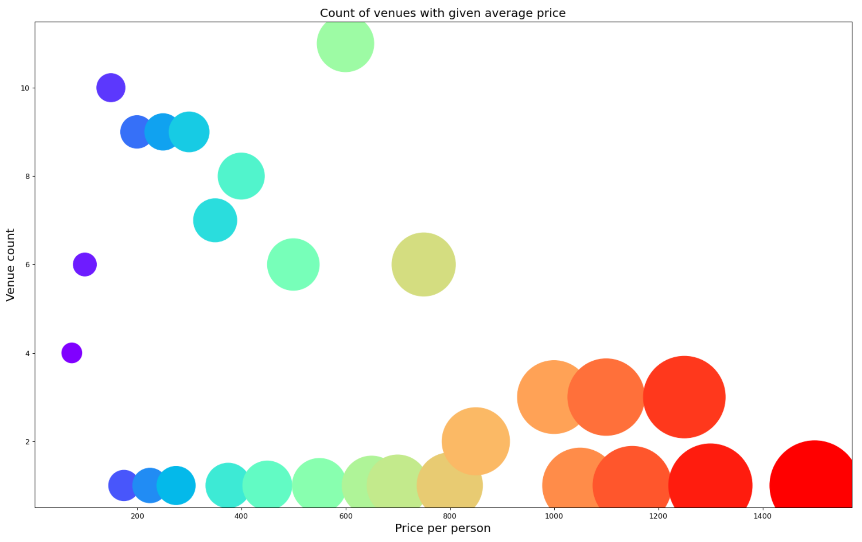
Data analysis: Average Price range per person

Slide 11
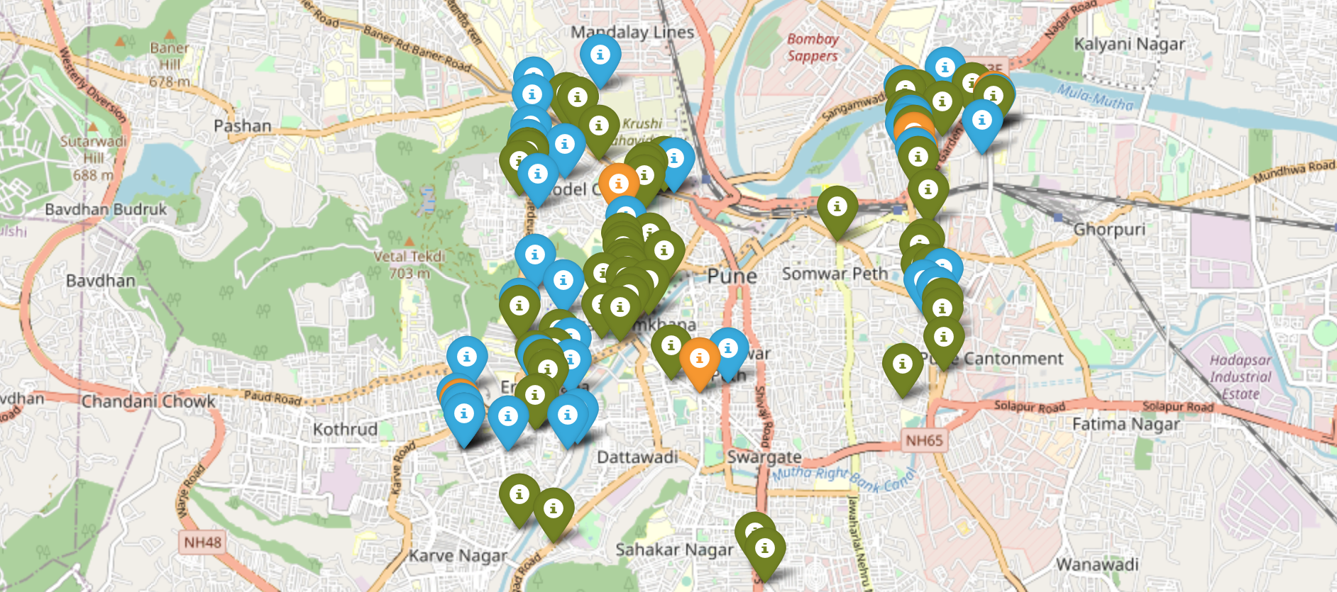
Plot of venues with different ratings

Slide 12
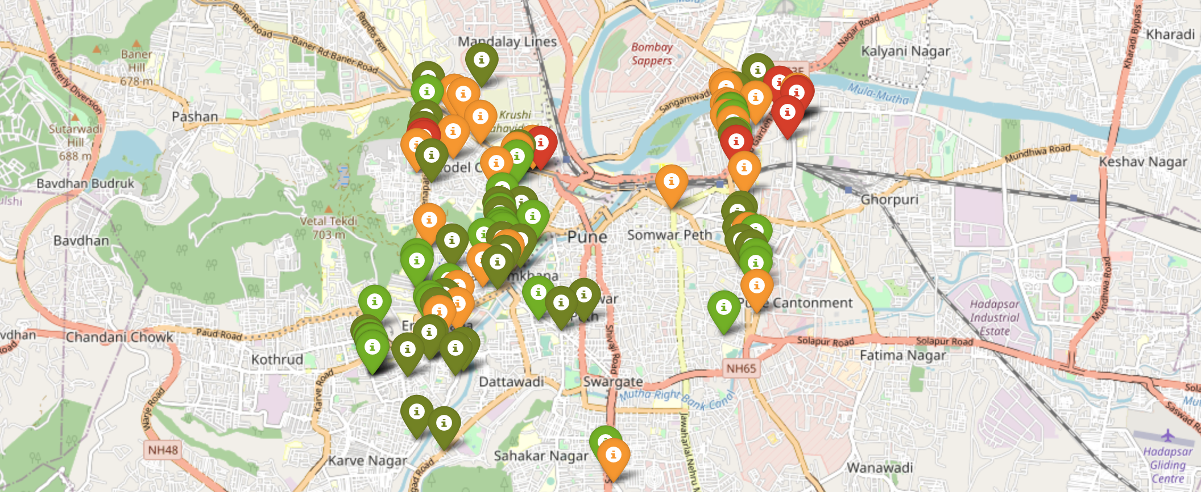
Plot of venues with Price Range

Slide 13
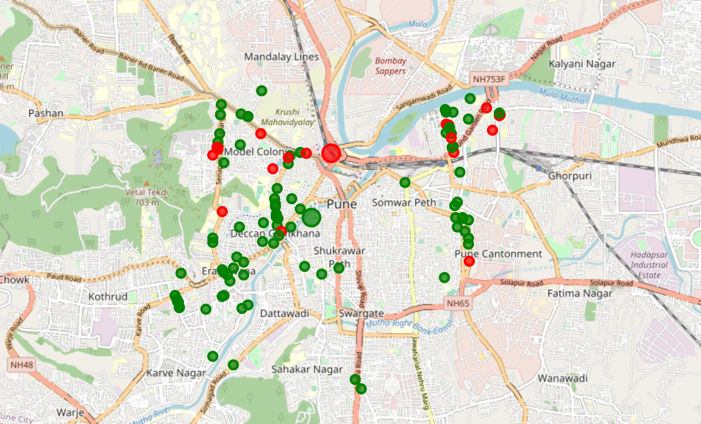
Clustering of venues

Slide 14
RESULTS
Majority of venues were Indian restaurants and vegetarian/vegan restaurants
While the ratings range from 1 to 5, majority venues have ratings close to 4
Most restaurants provide good quality food which is liked by the people of the city, thus indicating the high rating
Finally, through clusters we identified that there are many venues which are relatively lower priced but have an average rating of 3.97
On the other hand, there are few venues which are high priced and have average rating of around 4.12
Even though we found range variation in prices is very large, given the complete range starts from Rs 100 and goes until Rs 1200; we can find venues providing good quality food in reasonable price as well
A visitor can find affordable restaurant of his/her interest with help of rating, price
A company can use this information to build up an online website/mobile application, to provide users with up-to-date information about various venues in the city based on the search criteria (name, rating and price).

Slide 15
Conclusion
The purpose of this project was to explore the places that a person visiting to Pune.
The venues have been identified using Foursquare and Zomato API and have been plotted on the map.
The map reveals that there are so many places where one can visit during his/her stay in Pune.
Based on the visitor's venue rating and price requirements, he/she can choose the places.
A company can use the information to build up an online website/mobile application, to provide users with up-to-date information about various venues in the city based on the search criteria (name, rating and price).

Slide 16
Thank you

